Slide 1



Day 08
contact@anubhavtrainings.com
ABAP RESTFUL APPLICATION PROGRAMMING

Slide 2

Agenda – Day 08
Fiori App with Launchpad in BTP
Service Consumption Model
Describing the Concept of Custom Entity
Why we use Custom Entity
Implement Custom Entity
Create Class for Custom Entity
Test Custom Entity
What is ABAP Git
Why we use ABAP Git
ABAP Git Integration
Understand How to Use ABAP Git

Slide 3
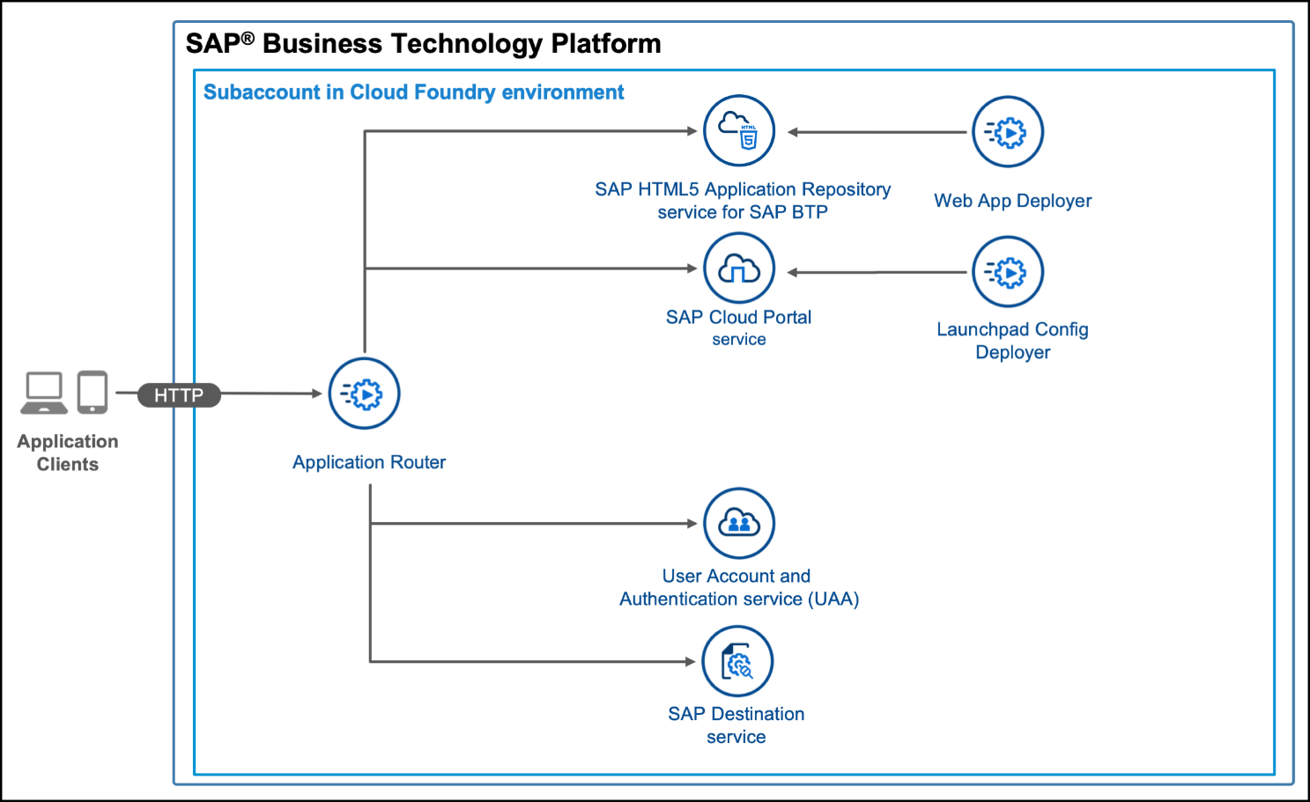
Check the Deployed App
We can use below commands to check deployed apps in BTP
cf html5-list
cf html5-list -di destname -u
https://sap.github.io/cf-html5-apps-repo-cli-plugin/

Slide 4
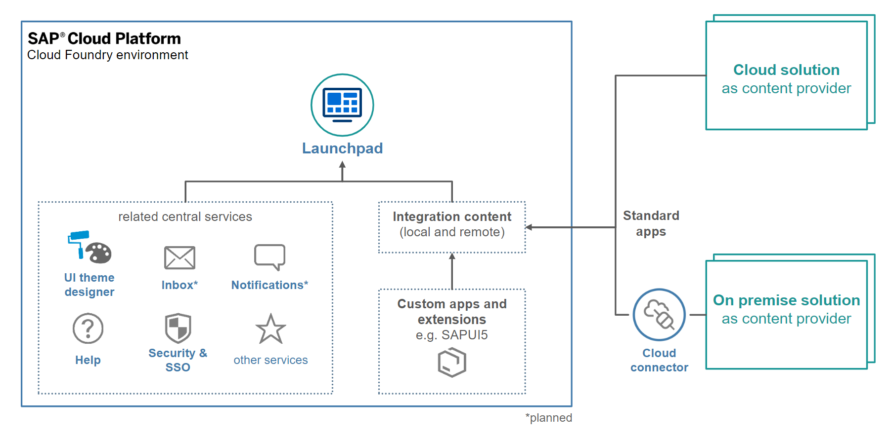
Fiori App with Launchpad and BTP
SAP BTP Platform Launchpad service is a new service on SAP Cloud Platform (Cloud Foundry) which is primarily focused on the enabling customers achieve a central Fiori Launchpad.

Slide 5
Introduction to Scenario & Flow
we want to replace the travel agencies data of our managed travel app with the results of the remote OData service that provides different set of travel agencies from other system altogether. For this use case, we shall leverage the concept of a custom entity. In contrast to "normal" CDS views that read data from the database tables or other CDS views, the so called custom entities act as a wrapper for a code based implementation that provides the data instead. This use case involves following steps.
Creating the Service Consumption Model
Defining the Custom CDS Entity
Create a class that implements the query for the custom entity
Agency
Custom Entity
Implanting class
Fiori App
OData
CDS
Agency
/DMO/AGENCY

Slide 6
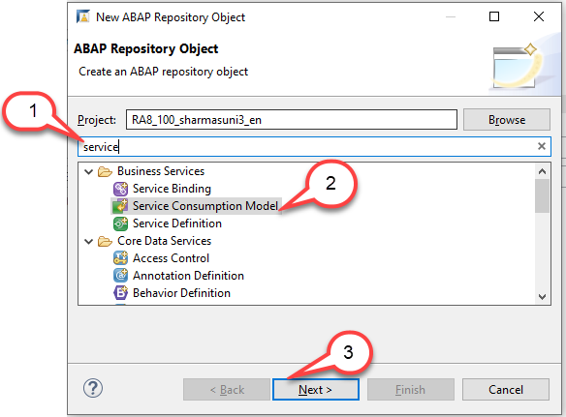
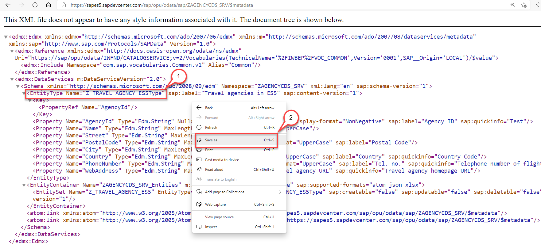
Creating the Service Consumption Model
Create an OData service consumption model in an SAP Business Technology Platform, ABAP Environment instance. In a second instance, prepare it for consumption.
Step1: Download $metadata file https://sapes5.sapdevcenter.com/sap/opu/odata/sap/ZAGENCYCDS_SRV/$metadata
Step2: Create the Service Consumption Model

Slide 7
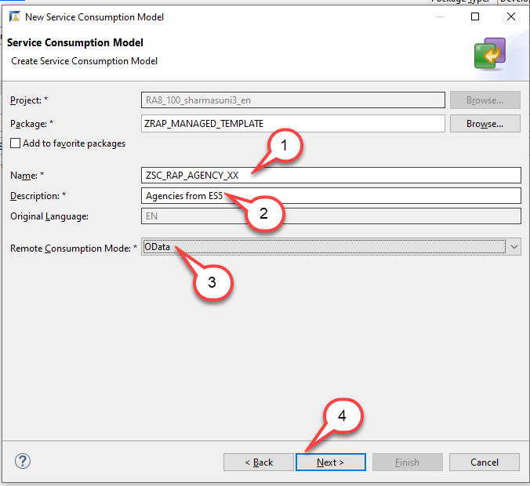
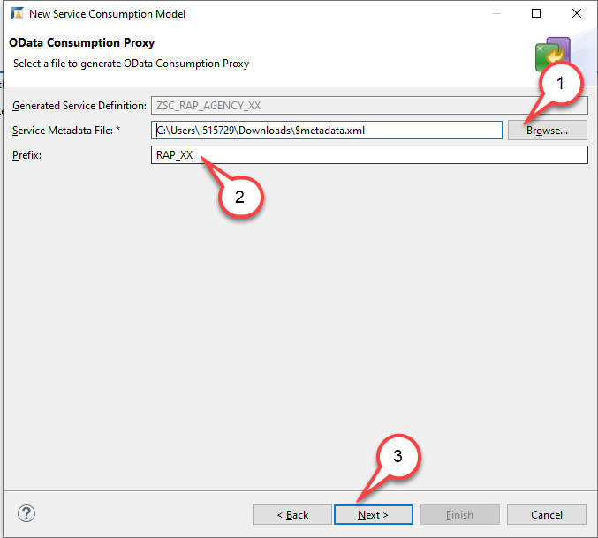
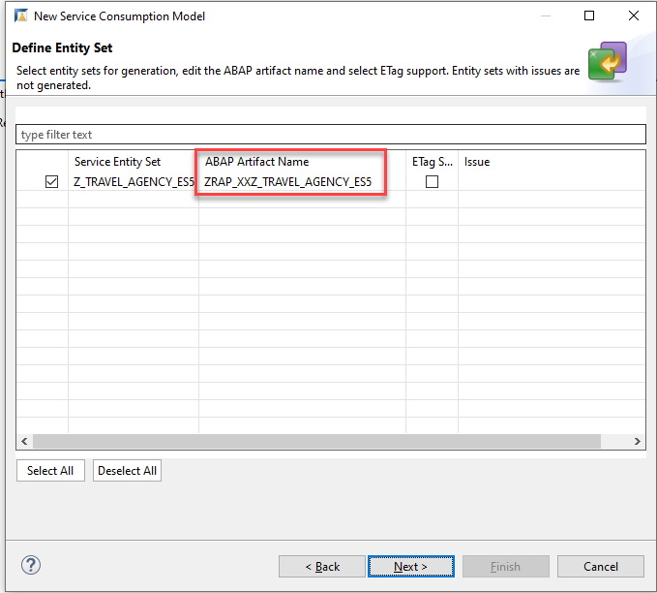
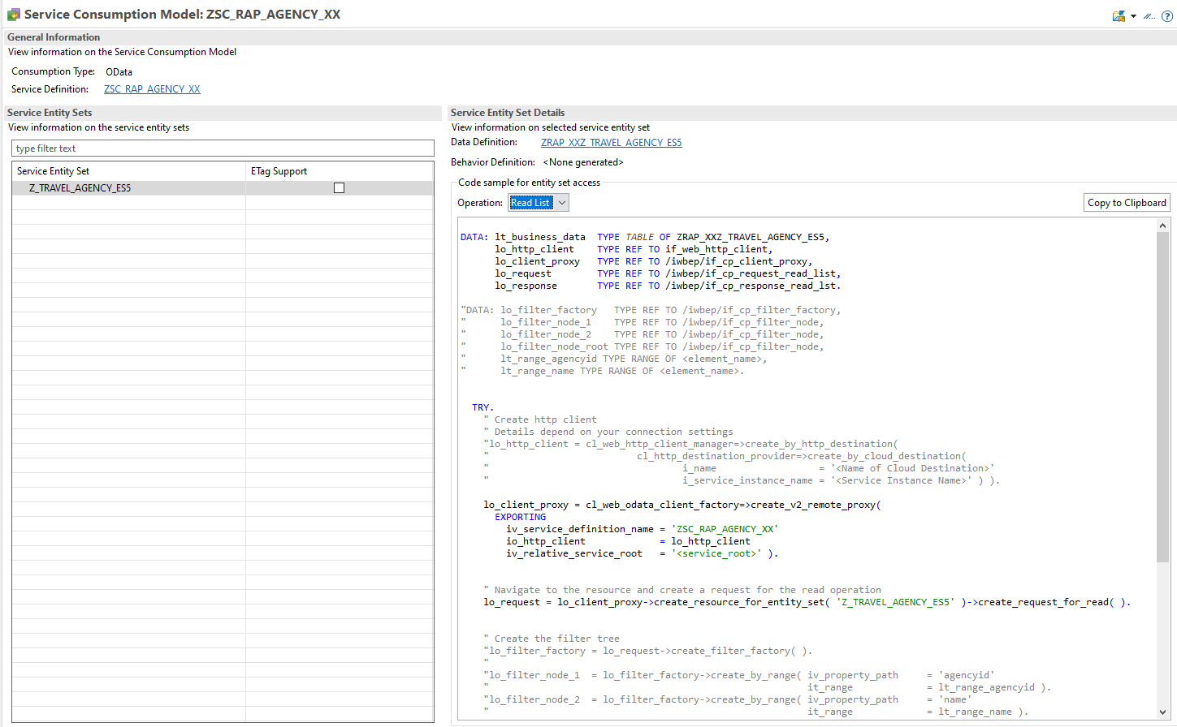
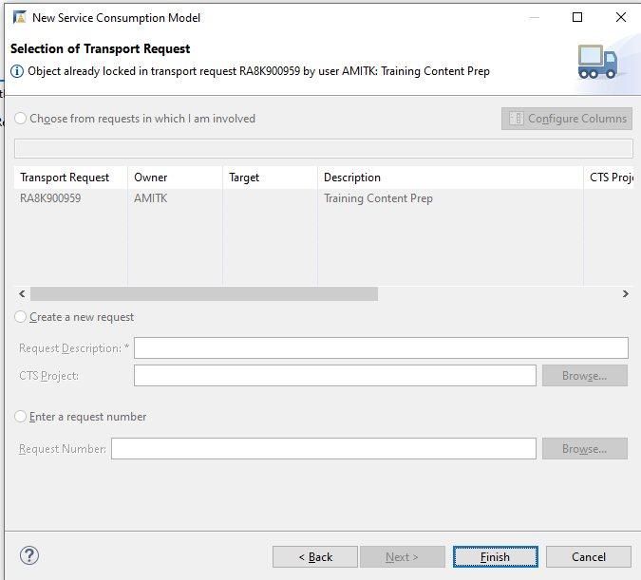
Creating the Service Consumption Model
Steps for Creating Service Consumption Model Click Next to Each step and finish.
For each operation (Read List, Read, Create, Update and Delete) some sample code has been created that you can use when you want to call the OData Service with one of these operations. Since we want to retrieve a list of Agencies, we will select the operation Read List and use this code.

Slide 8
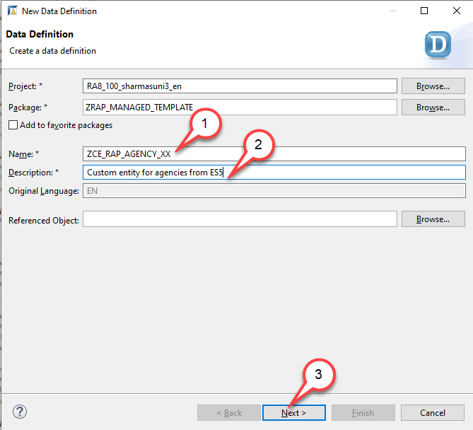
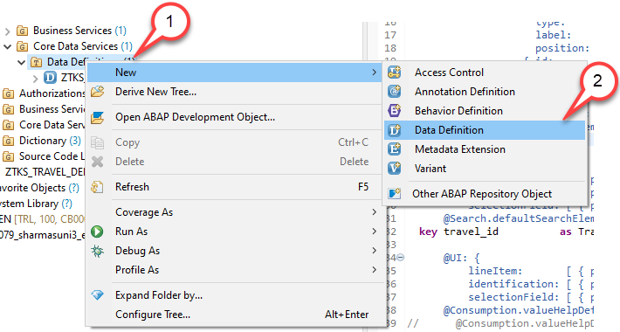
Defining the Custom CDS Entity
The custom entity must be created manually with similar syntax as the abstract entity that has been created when we have created our service consumption model. To leverage the remote OData service in our application we have thus to perform two steps: o We must create a custom entity. o We must create a class that implements the query for the custom entity. Create a custom entity
1. Right-click on the folder Data Definition and select New Data Definition.
2. Start with creating a new data definition ZCE_RAP_AGENCY_XX using the template for a Custom Entity.
The New Data Definition dialogue opens…

Slide 9
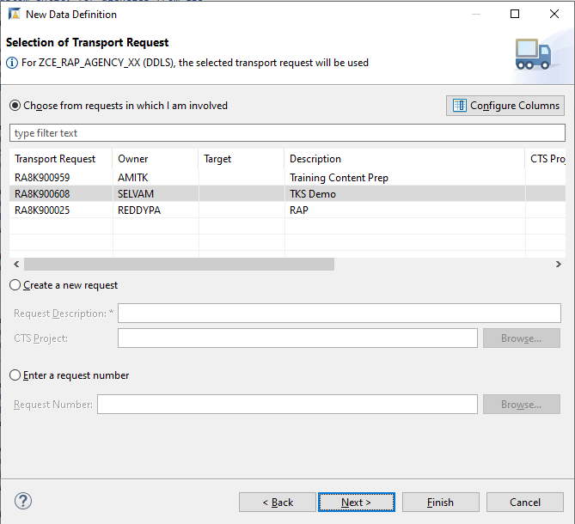
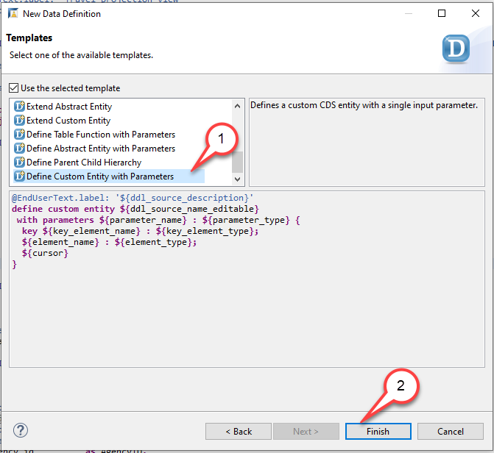
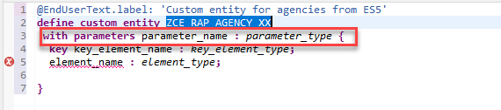
Creating Custom Entity
Press Next. Do NOT press Finish. Caution If you would press Finish instead of Next the wizard will use the template that was used the last time when this wizard was used by the developer.
4. Select the template Define Custom Entity with Parameters. Press Finish…
5. Edit the source code of the custom entity ZCE_RAP_AGENCY_XX Remove the statement with parameters parameter_name : parameter_type

Slide 10
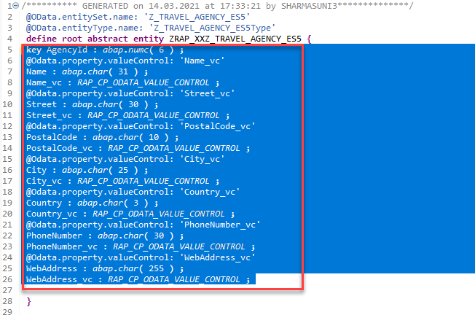
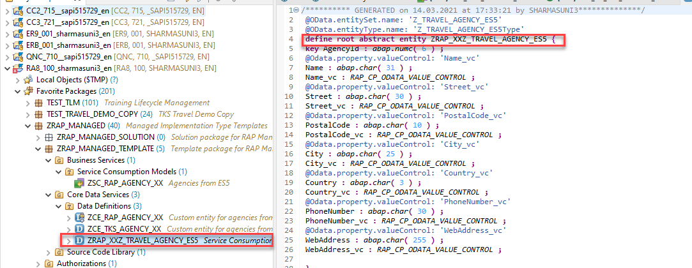
Creating Custom Entity
6. Now, open the abstract entity you created in Service Consumption Model in the source code editor Navigate to the abstract entity ZRAP_XXZ_TRAVEL_AGENCY_ES5 in the Project Explorer Double click on it to open the source code editor
7. Copy field list from abstract entity to custom entity Copy the field list from the abstract entity and paste it between the curly brackets as the new field list of the custom entity, thereby replacing the field list provided by the code template. You can make use of the Source Code Formatter (SHIFT+F1) to format the source code.

Slide 11
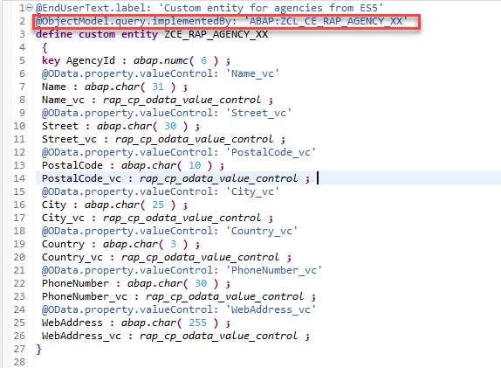
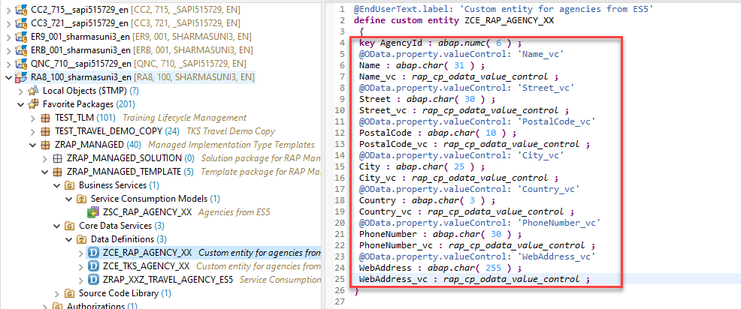
Creating Custom Entity
8.Paste the code in our Custom Entity
9. Add the annotation @ObjectModel.Query.ImplementedBy
to the DDL source code @ObjectModel.query.implementedBy: 'ABAP:ZCL_CE_RAP_AGENCY_XX' and activate your changes.

Slide 12
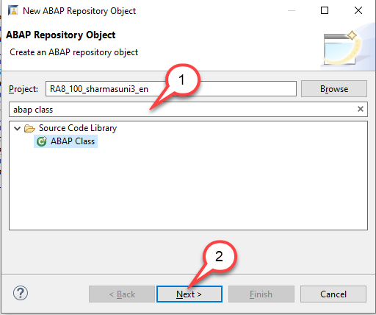
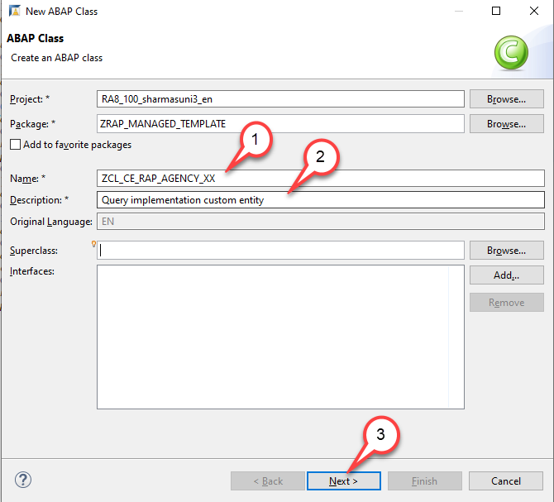
Create a class that implements the query for the custom entity
To be able to use our class as a query implementation class of our custom entity our class must implement the interface if_rap_query_provider. We will thus add this interface to it.
1.Search for ABAP class and press Next
2.Create a new ABAP class ZCL_CE_RAP_AGENCY_XX for custom entity ZCE_RAP_AGENCY_XX. The New Data Definition dialogue opens

Slide 13
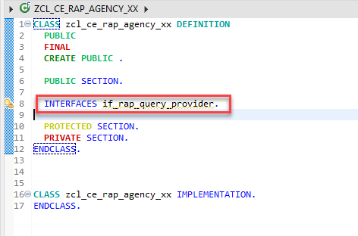
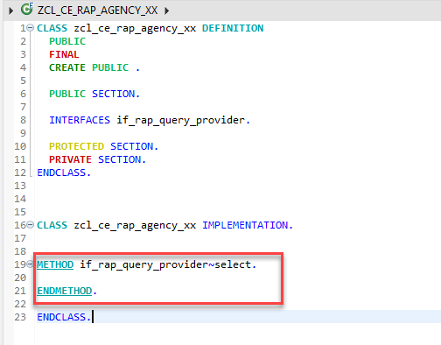
Class Implementation
3. Add interface IF_RAP_QUERY_PROVIDER to the query implementation class ZCL_CE_RAP_AGENCY_XX Add the following statement in the public section INTERFACES if_rap_query_provider.
4. Add an implementation for the method if_rap_query_provider~select.
Code here for Method

Slide 14
Something Important
Implement the method if_rap_query_provider~select. Within the select() method, we can retrieve the details of the incoming OData call using the object io_request. Using the method get_paging() we can find out whether client side paging was requested with the incoming OData call. Using the method get_filter() we can retrieve the filter that was used by the incoming OData request and by calling the method ->get_as_ranges( ) provided by the filter object we can retrieve the filter as ranges. Using the methods is_data_requested( ) and is_total_numb_of_rec_requested( ) we are able to find out whether the incoming request requests that business data is returned and whether the request contains a $count.
Please note:
If business data is requested, It is mandatory to add the retrieved data via the method set_data() .
If in addition, the number of all entries of an entity is requested, the number of entities being returned must be set via the method set_total_number_of_records(). Copy and paste the coding below into the implementation of the method if_rap_query_provider~select.

Slide 15
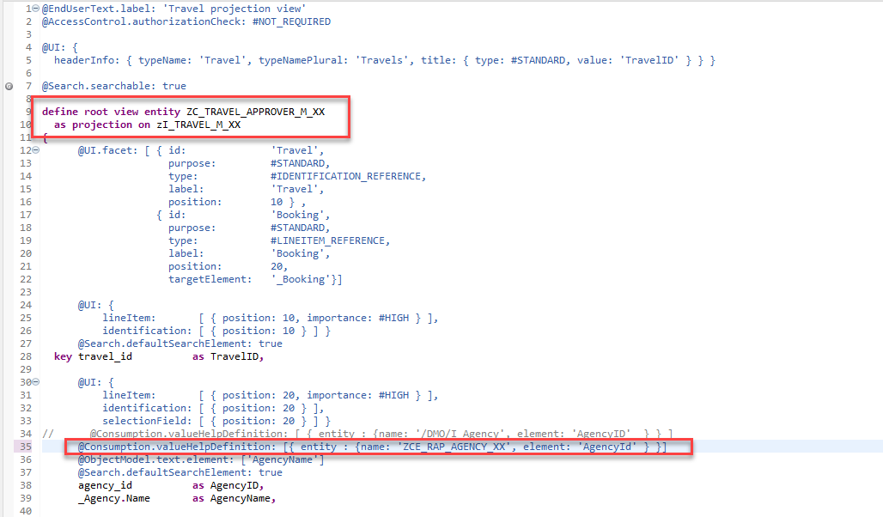
Test the Custom Entity in Projection CDS
You have implemented the query implementation class of the custom entity. As a result we can now enhance the implementation of our managed business object that we have created to use the custom entity as a value help Enhance the manage BO entity

Slide 16
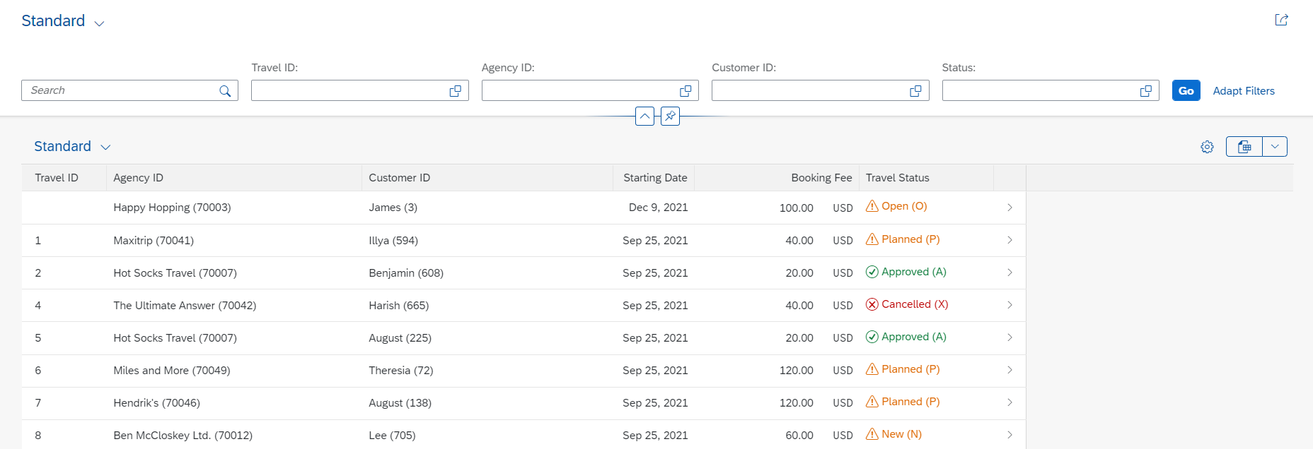
Enabling Status with Icon
A Status with icon provide more intuitive analysis of the data to the business user, using the criticality annotation available at the LineItem level, we can design and deliver best in class user experience with RAP and CDS entities.
Exercise - Solution

Slide 17

What is Git ?
Git is a free and open source distributed version control system designed to handle everything from small to very large projects with speed and efficiency.
Git is easy to learn and has a tiny footprint with lightning fast performance. It outclasses SCM tools like Subversion, CVS, Perforce, and ClearCase with features like cheap local branching, convenient staging areas, and multiple workflows.

Slide 18
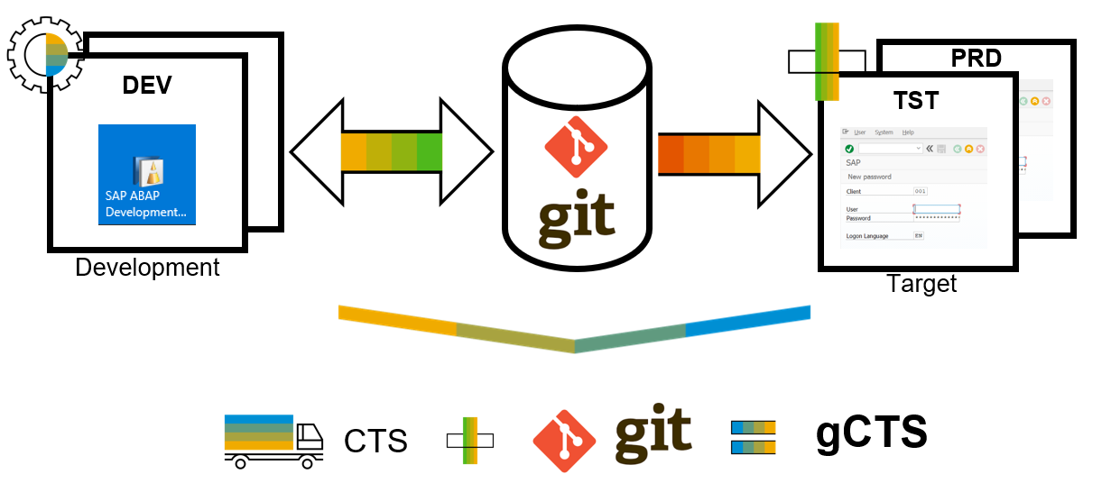
What is ABAP Git ?
abapGit is a tool to import and export code between ABAP systems. If a developer has a developer key to the system, the developer can perform these actions already. abapGit enables the developer to do mass export/changes/imports but not more than already possible to do manually.
Running automated security checks on the abapGit code will by design give a lot of errors, as abapGit will import, overwrite and change ABAP artifacts in the system in ways that might not be intended. Always review all code in remote repositories before importing to the target system, this is possible because abapGit is plain text unlike traditional transport files.
That being said, abapGit is used by mutiple organizations, all abapGit changes are reviewed via pull requests. And all 100+ repository watchers are automatically notified for every change to the code base, so potentially all changes are looked at by more people than tradtional enterprise products.

Slide 19
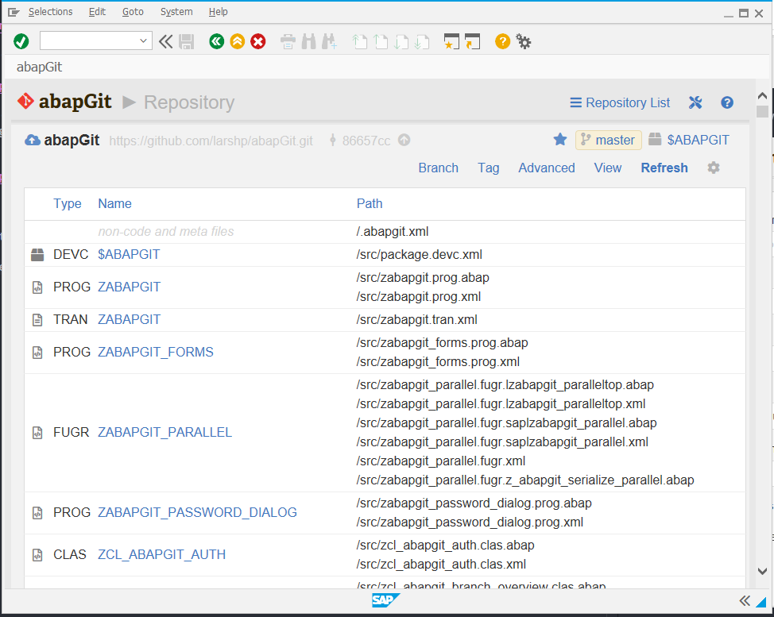
ABAP Git
It is a community effort to support the project, recommend watching the project to get a feeling about issue resolution. Everyone can suggest changes to abapGit via pull requests.

Slide 20
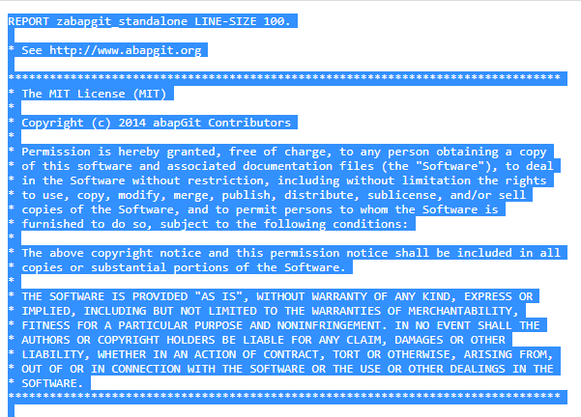
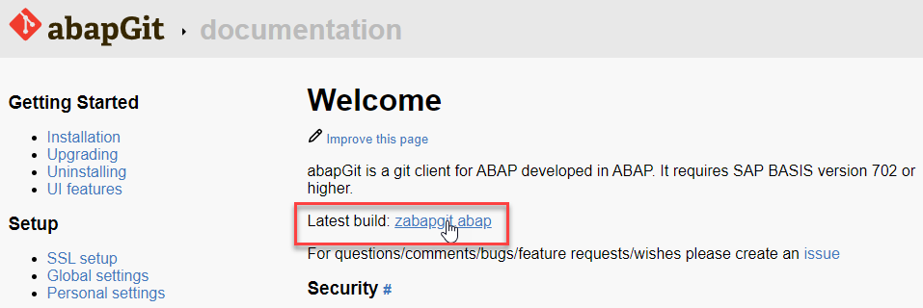
ABAP Git Integration
Step 1. Go to https://docs.abapgit.org/ in browser and click on Latest Build.
Step 2. Copy this Code.

Slide 21
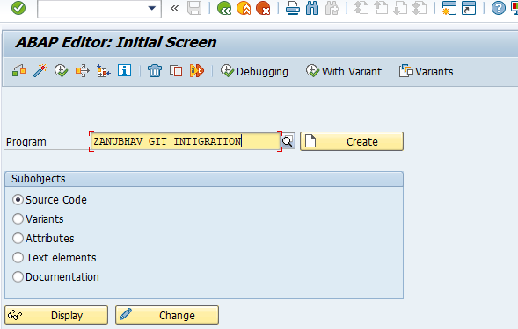
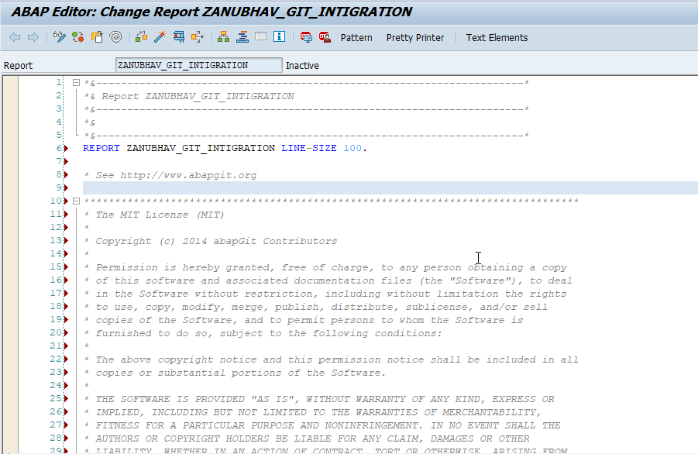
ABAP Git Integration
Step 3. Open SAP Gui Go to T-Code SE38 for Building Report, give any name to report and click on create.
Step 4. Paste the Copied Copy in this report.

Slide 22
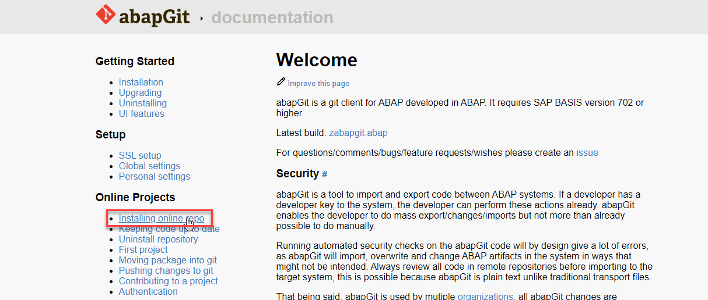
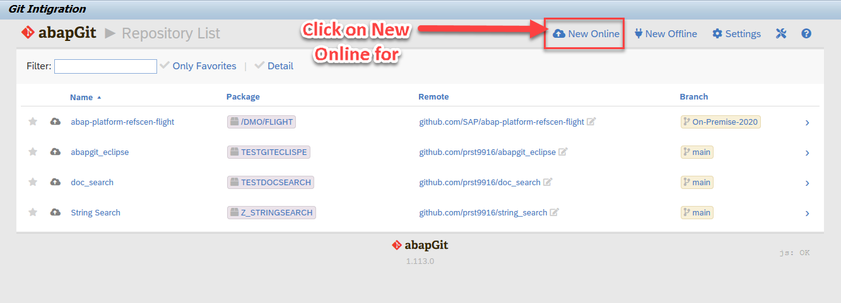
ABAP Git Integration
Step 5. After the Execution, abapGit Screen
Step 6. Go back to Bowser side and click on Installing Online Repo

Slide 23
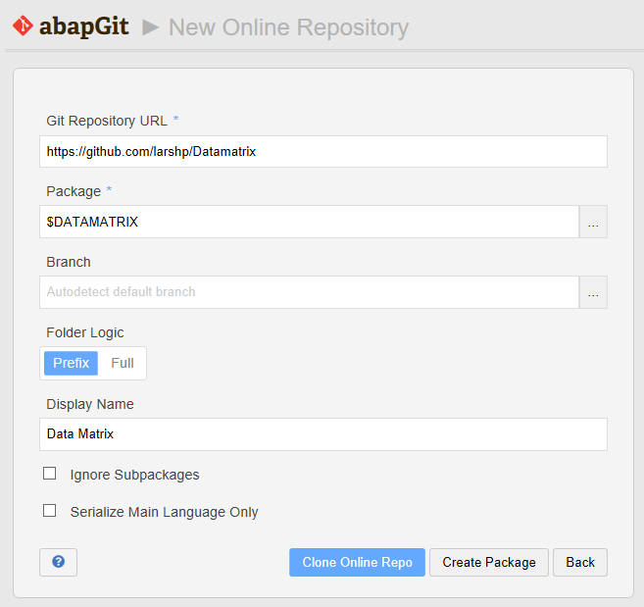
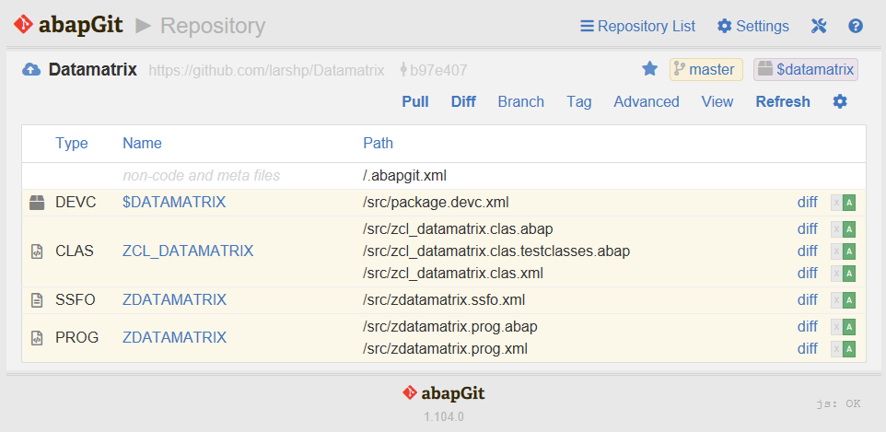
ABAP Git Integration
Step 7. Enter the url for the Github project, eg https://github.com/larshp/Datamatrix along with a package name, eg. $DATAMATRIX. If the package does not exist yet, it will be created automatically when pulling. Alternatively, you can select “Create Package” to create the package manually with your own settings.
Step 8.Select “Clone Online Repo”
Select “Pull” to copy all objects from the Git repository into the SAP system

Slide 24

End of Day 08
Trainer: Anubhav Oberoy

Slide 25
Trainer: Anubhav Oberoy

Slide 26
THANK YOU
If you cannot do
great things, do small things in a great way.
Anubhav Oberoy
https://www.anubhavtrainings.com

Slide 27


We’re committed to empower you to be
Most Desirable Resource
through powerful training solutions.
We build the workforce of the future.
250+
Corporate Clients
30,000+
Learners Trained
25000+
Learners Placed
FREE WEBINARS
Sign up for free webinars with industry experts every fortnight!
Enroll Now!
Contact us today!
https://anubhavtrainings.com/

Slide 28




More from AnubhavTrainings.com

